Slide 1
Corning Scope 3 Emission Program – Setting a Science Based Target

Slide 2
Information security
This presentation contains Corning information and is intended solely for those with a need to know. It may not be distributed, in whole or part, in any form by any means, or by any person or organization without authorization from Corning Incorporated.
Notes:
This deck is for internal use only.

Slide 3
Setting a Science Based Target
Speakers
Susan McNichols
Project Consultant WSP,
Sustainability Energy and Climate Change
Angie Xiong
Project Director WSP, Sustainability Energy and Climate Change
Adeola Adeusi
Project Manager,
Global Supply Management Corning Inc.

Slide 4
Planned Training Webinars
Training Topic | Webinar Date
Scopes 1&2 Accounting Training | Complete
Scope 3 Accounting Training | Complete
Setting a Science Based Target Training | May 18th
Renewable Energy Target and Procurement Training | May 25th
Product Carbon Footprint Training | June 1st
Suppliers that are required to attend specific trainings based on maturity level will be notified by email. All trainings are optional for all suppliers.

Slide 5
Agenda
Setting a Science Based Target
Webinar Objectives
Corning Overview and Supplier Expectations
Science Based Targets and SBTi Overview
Next Steps
Resources
Emissions Reduction Levers to Achieve an SBT and Achievement Roadmaps
Reporting Targets through CDP

Slide 6
Webinar Objectives

Slide 7
Webinar Objectives
Understand what a science-based target is
Understand the SBTi requirements and goal setting timeline
Understand resources available to proceed in setting a science-based target approved by the SBTi
Understand how to enter target information into CDP

Slide 8
Corning Scope 3 Emission Program
Adeola Adeusi

Slide 9
Our Approach
To Sustainability
At Corning, we take a long-term approach to sustainability, as we address key challenges of the moment and evolve to meet the needs of the future.
We think about our contributions in two categories. One is our footprint – how our actions directly affect others in areas such as gender pay equity and carbon emissions from our operations. The other is our handprint – what we enable others to do through our products and services, such as helping to deliver over 8 billion COVID-19 vaccine doses to date through our glass vials.
We prioritize areas where we have distinctive capabilities to create value for our shareholders and meaningful progress for society. We also emphasize areas where our stakeholders are looking for us to set an example – areas such as supporting human rights in our supply chain, advancing gender equity, and acting with integrity in all we do. Investing in these areas also makes us more resilient and supports our ability to do what we do best – innovate.
“Quite simply, we’ve succeeded over the long term by always working to become better versions of ourselves. We never lose sight of our purpose, our Values, and the importance of engaging with – and delivering for – key stakeholders. And that’s “our why” – we always seek to advance and apply our leadership capabilities to make a positive difference in the world.”
Wendell P. Weeks
Chairman and Chief Executive Officer

Slide 10
2023 Corning Sustainability Goals
Reduce our absolute Scope 1 and 2 greenhouse gas (GHG) emissions 30% by 2028 from a 2021 base year
Reduce our absolute Scope 3 GHG emissions, covering purchased goods and services, capital goods, fuel- and energy-related activities, and upstream transportation and distribution 17.5% by 2028 from a 2021 base year
Increase our use of renewable energy by 400% by 2030 from a 2018 baseline
By the end of 2023, assess Corning’s exposure to water stress
By the end of 2024, Corning will be generating monthly, accurate, and comprehensive water use data for our top 10 water-use facilities
By the end of 2028, Corning will increase its waste diversion rate to greater than 80% globally
New!
By the end of 2023, Corning will be generating monthly, accurate, and comprehensive landfill waste and diverted waste data for our top 10 waste-generating sites
Certify 100% of our high-risk suppliers as socially responsible by 2025
Reduce our total recordable case incident rate (TRIR) within the portion of our operations that disproportionately contribute to our overall recordable injury and illness rate by at least 10%
Encourage increased volunteerism efforts year over year by supporting, rewarding, and recognizing employees’ efforts in the community
Achieve understanding of the Corning Code of Conduct, including how to report allegations of ethical or legal misconduct, among 100% of employees
New!
New!
New!
New!
Notes:
We have set goals within these focus areas and we are working diligently to achieve them. These goals were developed to support the united nations sustainable development goals aligning Corning’s efforts with global action on sustainability.
Didi will talk about our greenhouse gas reduction goals. We also introduced new water, waste and safety goals.
One that is very relevant to this group is our waste goals!
The following goals were graduated:
Maintain a diverse Board of Directors Corporate Governance and Risk Management
Conduct an annual review of the Sustainability Program by the Board of Directors Corporate Responsibility and Sustainability Committee Corporate Governance and Risk Management
Address environmental, social and governance issues in our Enterprise Risk Management Process Corporate Governance and Risk Management
Issue a sustainability report in 2021 and every year thereafter Transparency and Reporting
Continue advocacy for environmental and social issues Environmental and Social Advocacy SDG 12

Slide 11
Greenhouse Gas (GHG) Emissions Reduction Goals
In 2022, Corning submitted targets for validation to the Science Based Targets initiative (SBTi), underscoring our commitment to set near-term company-wide emission reductions in line with Climate science, and aligning with the goals of the Paris Agreement.

Slide 12
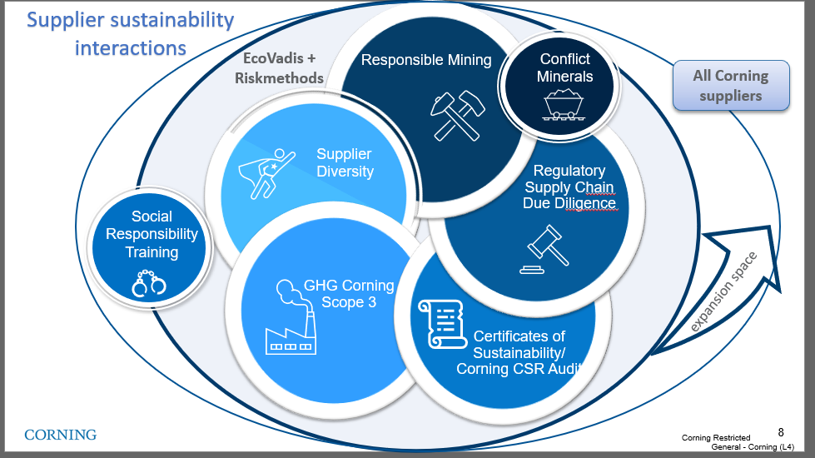
Climate Change is part of GSM's sustainability strategy
Our management of
Sustainable Supply Chain
Working with our suppliers globally, with a focus on Corporate Social Responsibility (CSR) and Climate Change Issues reduces our supply disruption risk and exposure to regulatory and reputational risk.
Our aim is to establish standardized, verified information-based management process contributing to Corning's long-term commitment on sustainable supply.
Supply Chain Sustainability Strategy
Scope 3 program
Last update Jan 2023
Notes:
CO₂ – Carbon dioxide
CH₄ – Methane
N₂O – Nitrous oxide (laughing gas)
HFC_{s} – Hydrofluorocarbons (refrigeration units, fire extinguishers, aerosols….)
PFC_{s} – Perfluorochemicals (heat, oil, water, etc., resistant coatings – think cookware, carpet stain prevention for regular people lives) mess up the endocrine activity, reduce immune function etc..
SF₆ – Sulfur hexafluoride – circuit breakers, arc suppressant , electrical insulator, semiconductor manufacturing, and the production of magnesium. One of the more potent GHG’s – it only takes a small amount to do significant damage. Used in the manufacturing as well as maintenance of grid equipment. One mitigation tactic is to regularly check equipment quality for leaks , training on employees how to maintain and service WHILE new options are being discovered.

Slide 13
2023 supplier engagement goals defined and set for deployment
Program
Deployment
Active Engagement
Emission Reduction Plan
Communicate supplier
engagement program to the suppliers that contribute 80% of Corning/Hemlock scope 3 emissions.
(PG&S, Capital Goods, Transportation)
Develop and implement emission reduction plans with supplier classified as engaged leaders in the scope emissions program
Actively engage and train the suppliers that contribute 60% of emissions in PG&S,CAP category and 80% in the Transportation
Corning approved channel
CDP supply chain program

Slide 14
2023 Supplier Activities for Scope 3 Emission
1
1
Register/ Sign up for CDP
If you company did not disclosure through CDP in 2022, please register your account.
2
Attend Trainings
2
GHG emission topics hosted by Corning/WSP
3
Calculate Emission data
3
Disclose scope 1, 2 and 3 greenhouse gas (GHG) emissions data. Provide independent or third-party assurance of disclosed emissions
4
Submit data and Allocate emission
4
Submit data through CDP. Deadline July 26th
5
Reduce Emissions
Adopt a science-based (SBTi-approved) emissions reduction target
Set a renewable energy target and water management goal
5

Slide 15
Partnership is Critical
Collaboration with suppliers will be key to enabling Corning to achieve our Scope 3 emissions reduction goal.
Working with Suppliers to Reduce Upstream Emissions
Together with our partners, Corning will continue to reduce global GHG emissions aligned with our commitment to climate action.
Corning will be rolling out our formal supplier engagement program in 2023 to reduce upstream emissions from suppliers systematically
Corning’s new product innovations are increasingly focused on reducing embodied carbon in our products and our customers’ products and operations.
Integrating Sustainability into Our Innovation Process
Corning has begun to use life cycle assessments performed by third parties to provide industry-recognized calculations of embodied carbon and we will request additional LCA information from suppliers through our supplier engagement program.
We are also developing GHG-impact estimates to be used in the early-stage design of products.

Slide 16
Corning Scope 3 Supplier Expectations
Suppliers engaged starting in 2023 are expected to adhere to these requirements by 2026:
Disclose scope 1, 2 and 3 greenhouse gas (GHG) emissions data through CDP Supply Chain
Provide independent or third-party assurance of disclosed emissions
Adopt a science-based (SBTi-approved) emissions reduction target
Set a renewable energy target
Respond to CDP Water Questionnaire
Set a water management goal

Slide 17
Science Based Targets and SBTi Overview

Slide 18
Poll the Audience
Setting a Science Based Target
Does your company have a GHG reduction target? If yes, is it science-based or have you considered setting a science-based target?
Please type your answer into the chat box

Slide 19
The Science Based Targets initiative
The Science Based Targets initiative (SBTi) strives to use the most up-to-date science to help companies align their business strategies with the goals of the Paris Agreement.
A consortium of 4 global NGOs:
2015 | 2016 | 2017 | 2018 | 2019 | 2020 | 2021 | May 2023
April: CEO letter calls for bold climate action at COP21 SBTi Goal: 100 companies committed by COP21 22 companies committed | 56 companies committed | 124 companies committed | 271 companies committed | 637 companies committed | 834 companies committed | 2253 companies committed | 4982 companies committed 2652 (53%) have set targets 1800 (36%) Net Zero Commitments
 |  |  |  |  | Objective: SBTs are standard business practice, corporations play a major role in global GHG reduction
Notes:
The Science Based Targets Initiative (SBTi) is a collaboration of four NGOs (CDP, the UN Global Compact, the World Resources Institute, and WWF) with a collective goal to motivate companies to take the lead in mitigating global climate change
Science-based target setting is now considered standard practice when companies set goals, and SBTi, as an independent third-party, validates the ambitions of targets proposed by applicants. SBTi approval adds credibility to your GHG targets, and alerts stakeholders that you are committed to meaningful climate action.
Setting SBTs shows that your company is taking a leadership position on climate which will bolster not only your scores and rankings on these frameworks, but also boost credibility and reputation among stakeholders, including investors, customers, employees, policymakers and environmental groups.
Science-based targets are company-level GHG reduction targets that consider the latest climate science, which indicates that significant global GHG emissions reductions are required to limit the worst effects of climate change.
Science-based target setting makes business sense – it future-proofs growth, saves money, provides resilience against regulation, boosts investor confidence, spurs innovation and competitiveness – while also demonstrating concrete sustainability commitments to increasingly-conscious consumers..
SBTi requires a complete scope 1, 2, and 3 GHG inventory (including all relevant emissions sources). Scope 1 and 2 ambition must be aligned with at least the 1.5 degree C climate scenario, while coverage of a scope 3 target must include at least 2/3 of total scope 3 emissions, and may align with at least the ‘well below’ 2 degree scenario.

Slide 20
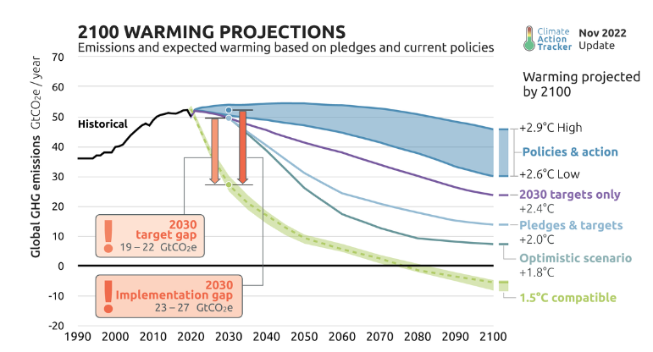
What is a Science-Based Target
Science-based targets (SBTs) shift the focus of corporate GHG reduction targets from doing good to doing enough.
Previously, target setting was a bottom-up exercise to determine what was feasible, using that as the basis for the target
SBTs use a top-down approach, setting the target ambition based on climate science and developing target achievement plans from there
1.5°C: Scenarios with a 50% probability of limiting warming in 2100 to 1.5°C (no or limited overshoot)
Well-below 2°C:
Scenarios with a 66% probability of limiting warming in 2100 to 2°C

Slide 21
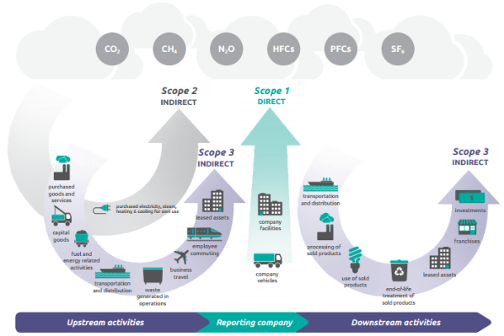
Operational Boundary: Scopes 1 , 2 & 3
GHG emissions are organized into categories, or “scopes”:
Scope 1: direct emissions from fuel combustion and refrigerant leakage from company facilities and vehicles
Scope 2: indirect emissions from the purchase of electricity, steam, heat, and cooling
Scope 3: indirect emissions from a company’s value chain (e.g., purchased goods and services, use of sold products)
Source: Greenhouse Gas Protocol Corporate Value Chain (Scope 3) Accounting and Reporting Standard - page 7

Slide 22
SBTi Near-Term Target Criteria
1
Time Frame
Must cover a minimum of 5 years and maximum of 10 years from the date the target was submitted for validation. For 1H 2023 submittal, end date must be between 2027 and 2032 inclusive and 2028 and 2033 inclusive for 2H 2023.
Base year must be no earlier than 2015
2
Boundary
Scopes 1 & 2: 95% coverage
Scope 3: 67% coverage. Scope 3 targets are required if a company’s scope 3 emissions are 40% or more of total scope 1, 2, and 3 emissions
3
Ambition
Scopes 1 & 2: Aligned with 1.5˚C pathway (4.2% linear annual reduction/yr) ¹
Scope 3: Aligned with well-below 2˚C pathway (2.5% linear annual reduction/yr) ¹
4
Methods
Absolute reduction (applicable to all scopes)
Sector-specific intensity convergence
Renewable electricity (scope 2 only, 80% RE by 2025, 100% RE by 2030)
Supplier engagement (scope 3 only) ²
Physical or economic intensity reduction (scope 3 only, 7% YoY)
¹ The 4.2% and 2.5% linear annual reductions are measured from the base year or 2020, whichever is earlier.
² Supplier engagement target must be achieved within 5 years of target submission date.

Slide 23
SBTi Net Zero Target Criteria
1
Time Frame
Target year can be no later than 2050
Base year should be the same as for the near-term target
2
Boundary
Scopes 1 & 2: 95% coverage
Scope 3: 90% coverage. Exclusions in the GHG Inventory and target boundary must not exceed 10% of total scope 3 emissions
3
Ambition
All scopes: Aligned with 1.5˚C pathway (90% reduction)
4
Methods
Absolute reduction (applicable to all scopes)
Sector-specific intensity convergence
Renewable electricity (scope 2 only, 100% RE)
Physical or economic intensity reduction (scope 3 only, 97% reduction)
¹ The 4.2% and 2.5% linear annual reductions are measured from the base year or 2020, whichever is earlier.
² Supplier engagement target must be achieved within 5 years of target submission date.

Slide 24
Time Frame: Base Year and Target Year Considerations
The base year is the start point for emissions reductions
The target year is the end point for emissions reductions
Base Year
Target Year
Tradeoff between the quality of base year inventory data versus the ability to “take credit” in the goal period for recent progress
Timing of recent acquisitions and ability to collect and reconcile past data also influences the base year decision
Needs to have comprehensive and verifiable Scope 1-3 inventory data
Should be representative of the company’s typical emissions profile (i.e., not impacted by Covid-19)
Ensure targets have sufficient forward-looking ambition (SBTi requires a base year no earlier than 2015)
A shorter-term goal provides more certainty with respect to business changes, growth, and initiatives
A longer goal period allows for a more aggressive goal, and provides flexibility in attainment
Near-term: Should be near enough to provide a meaningful milestone for prioritizing strategies and tracking emissions reductions but provide enough of a planning horizon so that it is feasible to achieve by that date
To ensure consistency with the most recent climate science and most current SBTi criteria, targets must be reviewed, and if necessary, recalculated and revalidated, at a minimum every 5 years

Slide 25
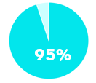
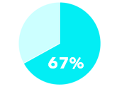
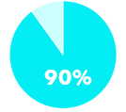
Boundary Considerations
Boundary: What Should be Included?
Scope 1 & 2
In practice, most companies include all scope 1 & 2 emissions Exclusions typically occur in unique cases such as a sensitive business acquisition, low transparency and confidence with data for a certain emissions category, or in the case that an emissions source technically falls within their GHG inventory boundary, but there is limited control
Scope 3
Near-Term |  | Net Zero
Prioritize large categories of emissions Data granularity allows for implementation and monitoring of GHG reduction levers Feasible GHG reduction levers exist and can be implemented in the near-term There is high confidence that GHG reductions can be achieved in selected categories |  | May exclude categories that are not material

Slide 26
Method Considerations
Methods: Pros and Cons of Target-Setting Methods
Target Type | Pros | Cons
Absolute | Designed to reduce absolute quantity of emissions Easy to communicate, transparent, and demonstrates strong ambition Lower data requirement, straightforward approach | Does not allow for comparison of GHG intensity among peers Does not communicate impact of efficiency improvements (reductions may result from decrease in production rather than improvements in performance) Target may be more challenging to achieve if the company grows and growth is linked to GHG emissions
Renewable Electricity (scope 2 only) | Straightforward to set Levers to achieve the target are clear Good option for companies with large scope 2 footprints | If company’s scope 2 emissions aren’t the majority, it may not address their entire scope 1 and 2 requirements May need to supplement with other scope 1 reduction levers
Physical Intensity (scope 3 only) | Allows for comparison among peers and can track performance over time Reflects GHG performance and efficiency improvements independent of business growth or decline Potentially more in line with internal progress tracking | Higher data requirement (e.g., units of product, mass of raw material, floor space) Difficult for companies with diverse products and operations to define a single physical intensity common business metric
Economic Intensity (scope 3 only) | Allows for comparison among peers and can track performance over time Provides more flexibility for companies that are prioritizing growth Suitable for companies that generate diverse products and services | Subject to extrinsic factors that can result in changes to the carbon intensity but are not linked to actual emissions reductions (e.g., fluctuation of commodity prices, inflation) Viewed as a less robust method due to volatility of economic metrics and the method’s reliance on idealized conditions where all companies grow at the same rate equal to that of GDP
Supplier Engagement (scope 3 near-term only) | Lower data requirement; enables action from companies with limited data or information on suitable reduction levers Scales up the adoption of SBTs globally | Less transparency and certainty of real emissions reductions since the target metric is percentage of suppliers or customers engaged Available strategies to achieve targets are limited given that the target focuses on engagement No requirement for suppliers to set SBTi-approved SBTs

Slide 27
Sample SBTi Setting Timeline Approval Summary
SBTi Commitment Letter Submitted
Submit SBTi Application
Gather data, set pathway, internal approvals
SBT Approval (will depend on the waiting list)
Sep​ | Oct​ | Nov​ | Dec​ | Jan​ | Feb​ | Mar​ | Apr​ | May​ | Jun​ | Jul​ | Aug​ | Sep​ | Oct​ | Nov​ | Dec​ | Jan​
Year 1
Year 2
Year 3
Goal achievement roadmap and action plan

Slide 28
SBT Considerations for SBTi Approval Summary
Target year should be 5-10 years from public enouncement
Companies are also encouraged to develop long-term targets (e.g., through 2050)
Boundaries should align with those of the company’s GHG inventory
SBTs should cover at least 95% of company-wide scope 1 and 2 emissions
Scope 2 should use a single, specified accounting approach (“location-based” or “market-based”) for setting goal and tracking progress
Scope 3 target should be set if scope 3 emissions are over 40% of total scope 1, 2 and 3 emissions
Should include at least the top 3 categories or 2/3 of total scope 3 emissions
SBTs should be periodically updated to reflect significant changes that would otherwise compromise their relevance and consistency, over time
Offsets and avoided emissions should not count toward SBTs
Companies must publicly report GHG emissions and progress against targets at least annually

Slide 29
Emissions Reduction Levers to Achieve a SBT and SBT Achievement Roadmaps
Susan

Slide 30
Poll the Audience
Setting a Science Based Target
Does your company have a GHG emissions reduction roadmap?
Please type your answer into the chat box

Slide 31
Emissions Reduction Levers to achieve an SBT
Facility
Energy Efficiency
Results in reductions of scope 1 and 2 emissions
Powerful, cost-effective tool for achieving GHG reductions
On-Site
Renewable
Electricity
Results in reductions of scope 2 emissions
Provides direct GHG reductions, reputational benefits
Direct
Renewable
Electricity Sourcing
Results in reductions of scope 2 emissions
Promotes growth of clean energy market; provides direct GHG reductions, reputational benefits​
Renewable Energy
Credit (REC)
Procurement
Results in reductions of scope 2 and 3 emissions
Enable near-term goal achievement but come with annual cost premium
Fuel Switching
Results in reductions of scope 3 emissions
Further invest in R&D to meet market expectations for alternative fuel trucks
Product Design
Results in reductions of scope 3 emissions
Design products with raw materials with lower carbon footprint using PCF for evaluation
Procurement Spend
Results in reductions of scope 3 emissions
Require key suppliers to set science based GHG emission reduction targets
Create procurement policies to align with reduction goals
Integrate GHG emissions into supplier code of conduct ​

Slide 32
Creating a Roadmap for Target Achievement
SBT Roadmap
Identify key levers and projects to reduce GHG emissions
Estimate project impact
GHG emissions reductions
Energy reductions
Worker safety improvements
Other project benefits
Estimate financial implications
Capital costs
Savings - Operation and Maintenance
Simple Payback
Build buy-in with key stakeholders
Ultimate decision makers
Sources of funding
Execution teams
Notes:
Once you’ve set a target, it’s important to create a roadmap to achieve it.
First identify potential projects that would reduce GHG emissions
Then estimate the project impact in terms of emissions reductions, energy reductions, and other project benefits, like worker safety improvements
Next estimate the financial implications, like capital costs, operations and maintenance savings, and simple payback
These metrics can help build the business case for investing in target achievement
You will want to present the above metrics to the ultimate decision makers, and identify sources of funding and the internal teams who will execute them
This chart is an example of such a roadmap for the previous slide’s target of an 18% reduction from 2018 to 2025.
You can see that they have identified 5 different project types: HVAC upgrades, renewable energy purchases, low GWP gases to replace GHG intensive ones, equipment controls like daylighting and motion sensors, and lighting upgrades like switching to LEDs

Slide 33
Planning for Target Achievement
Illustrative SBT Roadmap – Scope 1 and 2
Energy efficiency
Process efficiency
Equipment upgrades
Renewable energy
Electrification
Illustrative

Slide 34
Planning for Target Achievement
Illustrative SBT Roadmap – Scope 3
Supplier GHG Reduction Targets
Reduction of Fuel and Energy Related Emissions
Product Innovation
Supplier Innovation
Reduction of transportation emissions
Illustrative

Slide 35
Reporting Targets Through CDP

Slide 36
Reporting GHG Targets: C4.1
Reporting Targets through CDP
What you select here will determine which questions appear next
You have an “active target” if the target ends in or after the reporting year and the target is to reduce absolute emissions or emissions intensity
What you select here determines the next questions that appear
(C4.1) Did you have an emissions target that was active in the reporting year?
Select from:
Absolute target Intensity target Both absolute and intensity targets No target
Absolute Target
A reduction in actual emissions in a future year when compared to a base year.
Example
We commit to reducing our Scope 1 and 2 GHG emissions by 30% from 2015 to 2030
Intensity Target
A reduction in emissions that have been normalized to a business metric when compared to the same normalized metric emissions in a base year.
Example
We commit to reducing our Scope 1 and 2 GHG emissions per revenue by 50% from 2020 to 2030
Notes:
Presenter: WSP
Now we will talk about how to enter your target information into CDP. The first question about targets is C4.1, and your response to this determine which questions appear next in the questionnaire
You simply select from the dropdown menu which type of target or targets you have. As a reminder, we’ve included the definitions of absolute and intensity targets here, along with examples of each.
We’ll use this example of an absolute target to show how to answer the next question.

Slide 37
Reporting GHG Targets: C4.1a, Absolute Targets
Reporting Targets through CDP
Complete ALL fields - do not leave any fields blank
Example Target
We commit to reducing our Scope 1 and 2 GHG emissions by 30% from 2015 to 2030
(C4.1a) Provide details of your absolute emissions target(s) and progress made against those targets.
Aspect | Guidance | Example
Target reference number | Select a unique target reference from the drop-down menu provided to identify that target in subsequent questions | Abs1
Is this a science-based target? | Select yes or no | Yes
Target ambition* | To be SBT approved it must be 1.5°C aligned for S1 and 2 and Well-below 2°C aligned for S3 | 1.5°C aligned
Year Target was set | The year in which your company has set the target | 2016
Target Coverage | The target coverage should match your GHG inventory boundary to be SBTi approved and should be company-wide | Company-wide
Scope(s) | Select from dropdown This refers to the Scope(s) of emissions to which the target relates | Scope 1+2
Scope 2 accounting method | Select Location-based or Market-based aligned with your GHG inventory reporting method | Market-based
Base Year | The year against which you are comparing your reduction target | 2015
Notes:
Presenter: WSP
If you select that you have an absolute target, C4.1a will appear. Connecting to the earlier Anatomy of a Target slide, this question has fields to capture each key element of the target language. We have used the same example here
There are a lot of elements to this question, so we’ll split it onto 2 slides. You start with selecting a reference number for your target - this allows you to consistently report on your targets from year to year. If you have reported your target previously, you should use the same reference number to report that target this year. If it’s a new target, you should select a reference number that you haven’t used before.
As you can see here in this example, we fill each element of the target into the correct field - the scope of emissions covered by the target is Scope 1 and 2, location-based in this case. For the % of emissions in scope, you should list 100% if none of your emissions are excluded from the target. You then enter the level of ambition, which is 30% for this target, and the base year is 2015. The start year refers to the year in which your company set the target. In this case, we’ll say that this target was set in 2016.

Slide 38
Reporting GHG Targets: C4.1a, Absolute Targets
Reporting Targets through CDP
Complete ALL fields - do not leave any fields blank
Example Target
We commit to reducing our Scope 1 and 2 GHG emissions by 30% from 2015 to 2030
(C4.1a) Provide details of your absolute emissions target(s) and progress made against those targets.
Aspect | Guidance | Example
Base year Scope 1 emissions covered by target (metric tons CO2e) | Enter the total metric tons CO2e from scope 1 in the target base year | 30,000
Base year Scope 2 emissions covered by target (metric tons CO2e) | Enter the total metric tons CO2e from scope 2 in the target base year | 100,000
Total base year emissions covered by target in all selected Scopes (metric tons CO2e) | Enter the sum of all the emissions that are covered by the target | 130,000
Target year | The year which your target must be achieved | 2030
Targeted reduction from base year (%) | The % reduction to be achieved in the target year compared to the base year | 15%
Scope 1 emissions in reporting year covered by target (metric tons CO2e) | Enter the total metric tons CO2e from scope 1 in the reporting year covered by the target | 35,000
Notes:
Presenter: WSP
If you select that you have an absolute target, C4.1a will appear. Connecting to the earlier Anatomy of a Target slide, this question has fields to capture each key element of the target language. We have used the same example here
There are a lot of elements to this question, so we’ll split it onto 2 slides. You start with selecting a reference number for your target - this allows you to consistently report on your targets from year to year. If you have reported your target previously, you should use the same reference number to report that target this year. If it’s a new target, you should select a reference number that you haven’t used before.
As you can see here in this example, we fill each element of the target into the correct field - the scope of emissions covered by the target is Scope 1 and 2, location-based in this case. For the % of emissions in scope, you should list 100% if none of your emissions are excluded from the target. You then enter the level of ambition, which is 30% for this target, and the base year is 2015. The start year refers to the year in which your company set the target. In this case, we’ll say that this target was set in 2016.

Slide 39
Reporting GHG Targets: C4.1a, Absolute Targets
Reporting Targets through CDP
Complete ALL fields - do not leave any fields blank
Example Target
We commit to reducing our Scope 1 and 2 GHG emissions by 30% from 2015 to 2030
(C4.1a) Provide details of your absolute emissions target(s) and progress made against those targets.
Aspect | Guidance | Example
Scope 2 emissions in reporting year covered by target (metric tons CO2e) | Enter the total metric tons CO2e from scope 2 in the reporting year | 150,000
Total emissions in reporting year covered by target in all selected scopes (metric tons CO2e) | Enter the sum of the metric tons CO2e from scope 1 and 2 in the reporting year | 185,000
Does this target cover any land-related emissions? | Select from: Yes, it covers land-related emissions only (e.g. FLAG SBT) Yes, it covers land-related and non-land related emissions (e.g. SBT approved before the release of FLAG target-setting guidance) Yes, it covers land-related CO2 emissions/removals associated with bioenergy and non-land related emissions (e.g. non-FLAG SBT with bioenergy) No, it does not cover any land-related emissions (e.g. non-FLAG SBT) | No, it does not cover any land-related emissions (e.g. non-FLAG SBT)
Target status in reporting year | ● New ● Underway ● Achieved ● Expired ● Revised ● Replaced ● Retired | Underway
Notes:
Presenter: WSP
If you select that you have an absolute target, C4.1a will appear. Connecting to the earlier Anatomy of a Target slide, this question has fields to capture each key element of the target language. We have used the same example here
There are a lot of elements to this question, so we’ll split it onto 2 slides. You start with selecting a reference number for your target - this allows you to consistently report on your targets from year to year. If you have reported your target previously, you should use the same reference number to report that target this year. If it’s a new target, you should select a reference number that you haven’t used before.
As you can see here in this example, we fill each element of the target into the correct field - the scope of emissions covered by the target is Scope 1 and 2, location-based in this case. For the % of emissions in scope, you should list 100% if none of your emissions are excluded from the target. You then enter the level of ambition, which is 30% for this target, and the base year is 2015. The start year refers to the year in which your company set the target. In this case, we’ll say that this target was set in 2016.

Slide 40
Next Steps and Resources

Slide 41
Data & Information Needs and Next Steps​
Data Needs
Provide business growth projections (annual revenue, sq ft) and/or growth rate through 2050 or best available​
Total scope 1, 2 and 3 Emissions​
Next Steps​
Determine internal stakeholders required for target approval ​
Data / target modeling review​
Build buy-in with key stakeholders
Gain approval to set an SBTi approved target
Develop SBTi target and submit to SBTi for approval

Slide 42
Next Steps
Setting a Science Based Targets
Look forward to the upcoming Renewable Energy Target and Procurement Training on May 25th
Socialize new expectations of Corning suppliers
Adopt a science-based (SBTi-approved) emissions reduction target
We ask that your target be approved by the SBTi by 2026 at the latest
There are a wealth of resources available on the SBTi website to help you get started SBTi Resources (including Validation Protocol, Tool and Submission Form)

Slide 43
Target Setting Resources and Tools
CDP Guidance:
Note on science-based targets
Science Based Targets Initiative:
Overview: Science Based Targets Website
SBTi Corporate Manual
SBTi Resources (including Validation Protocol, Tool and Submission Form)
SBTi Net Zero Standard
World Resources Institute’s Greenhouse Gas Protocol:
Mitigation Goal Standard (2014): Mitigation Goal Standard
Corporate Accounting and Reporting Standard (2004): Corporate Accounting and Reporting Standard
WSP White Papers:
Science-based Targets
Inventory to Action
Green Power Procurement
United Nations Development Program & WRI:
Designing and Preparing Intended Nationally Determined Contributions (INDCs) (2015): Designing and Preparing INDCs
43
Notes:
Note that if they use a tool like this, we would like them to state that in their CDP response

Slide 44
Thank you for your continued support contact us at gsmsustainability@corning.com

Slide 45
Questions

